Slide 1

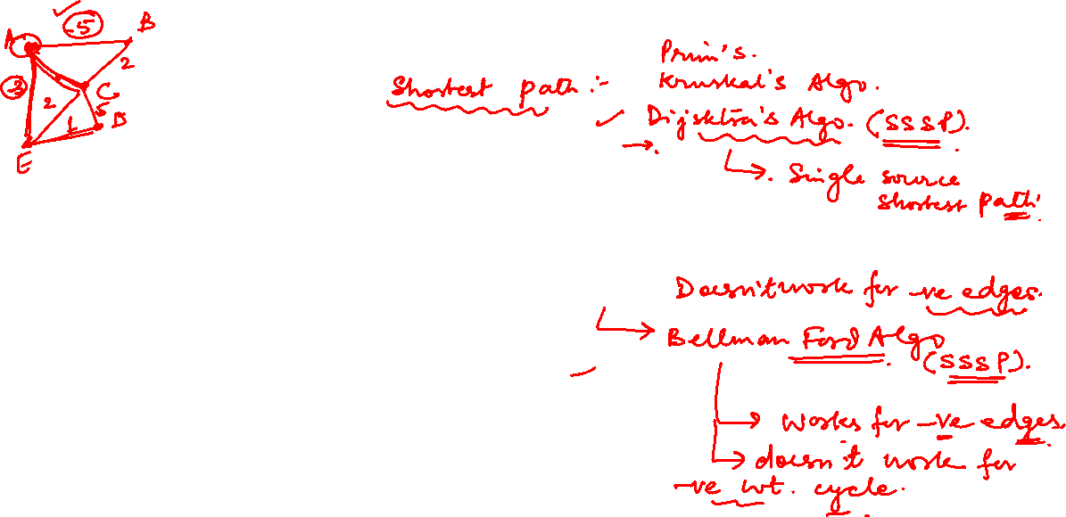
GRAPH THEORY AND ITS APPLICATIONS
Dr. Arti Arya
Department of Computer Science & Engineering

Slide 2
GRAPH THEORY AND ITS APPLICATIONS
Graph Applications
Dr. Arti Arya
Department of Computer Science & Engineering

Slide 3
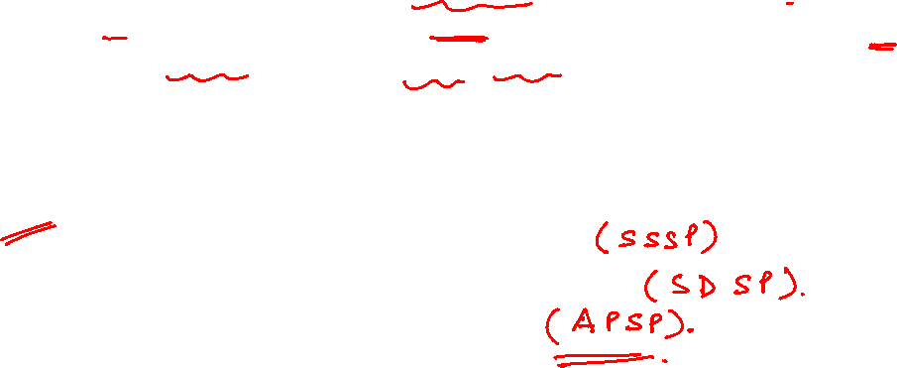
Graph Theory and its Applications Shortest Path Problem
In graph theory, the shortest path problem is the problem of finding a path between two vertices (or nodes) in a graph such that the sum of the weights of its constituent edges is minimized.
The variations of the problem are :
The single-source shortest path problem
The single-destination shortest path problem
The all-pairs shortest path problem

Slide 4
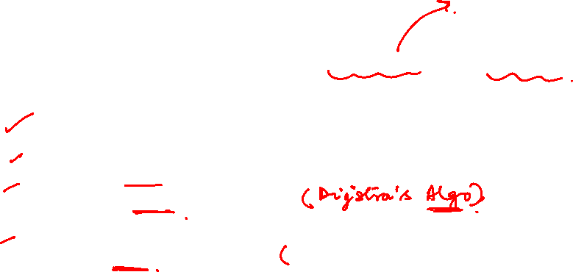
Graph Theory and its Applications
Shortest Path Problem
Dijkstra’s algorithm is one of the most popular algorithms for solving many single-source shortest path problems having non-negative edge weight.
Application Areas of Shortest Paths:
Network Routing(IP routing to find Open shortest Path First)
Transportation Logistics
Recommendation Systems
Digital Mapping Services in Google Maps
Social Network Analysis
Telephone Network
Designate file server
Robotic Path

Slide 5

Graph Theory and its Applications Shortest Path Problem
Single Source Shortest Paths Problem: Given a weighted connected (directed) graph G, find shortest paths from source vertex s to each of the other vertices.
Dijkstra’s Algo finds the shortest paths to a graph’s vertices in order of their distance from a given source.
Firstly, it finds the shortest path from the source to a vertex nearest to it, then to 2nd nearest and so on.
It works for directed or undirected graphs but doesn’t work for –ve edges.( Flyod’s and Bellman Ford works well for –ve edges)

Slide 6
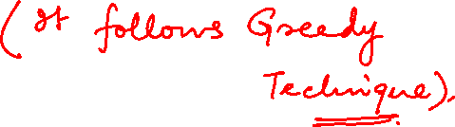
Graph Theory and its Applications Dijkstra’s Algorithm: Applications
Transportation Planning
Packet Routing in communication networks
Finding the shortest paths in social n/ws
Speech recognition
Can be used in Robotics
Path finding in video games
State Space Graphs

Slide 7
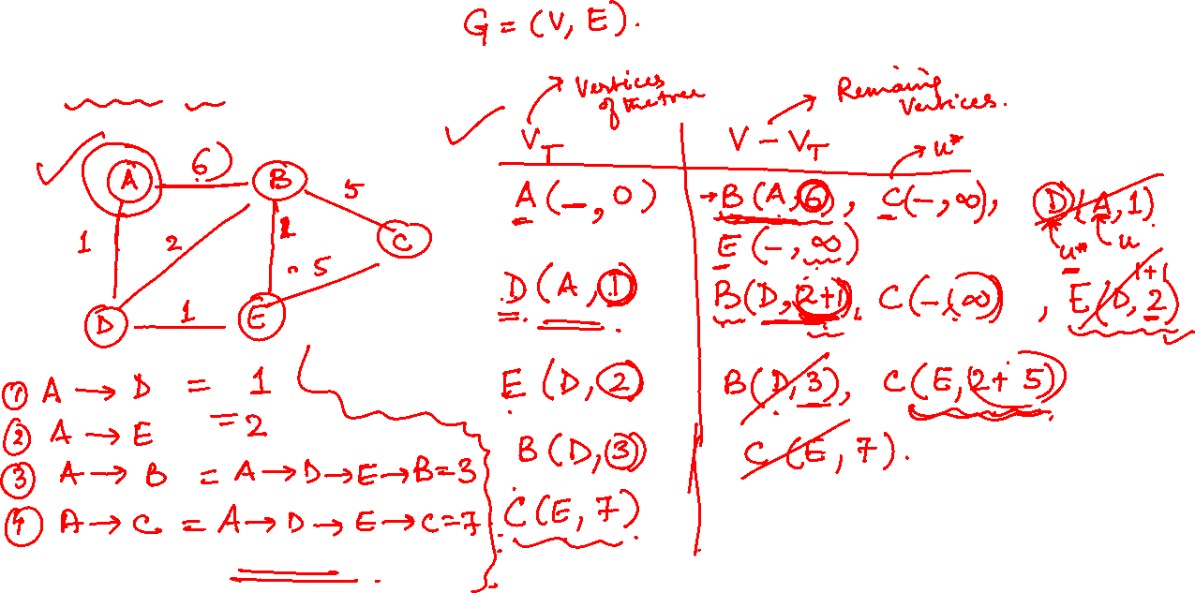
Graph Theory and its Applications Dijkstra’s Algorithm

Slide 8
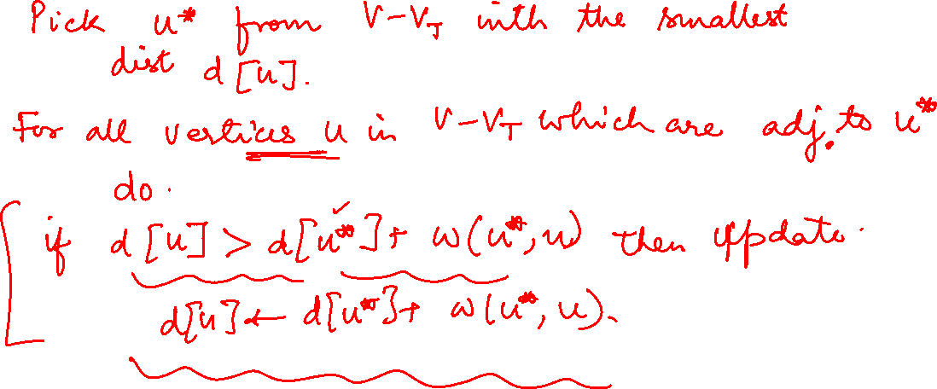
Graph Theory and its Applications Dijkstra’s Algorithm

Slide 9

Graph Theory and its Applications Dijkstra’s Algorithm
Single Source Shortest Paths Problem: Given a weighted connected (directed) graph G, find shortest paths from source vertex s to each of the other vertices
Dijkstra’s algorithm: Similar to Prim’s MST algorithm, with
a different way of computing numerical labels: Among vertices
not already in the tree, it finds vertex u with the smallest sum
d_{v} + w(v,u)
where
v is a vertex for which shortest path has been already found on preceding iterations (such vertices form a tree rooted at s)
d_{v} is the length of the shortest path from source s to v w(v,u) is the length (weight) of edge from v to u

Slide 10
Graph Theory and its Applications Dijkstra’s Algorithm
Example

Slide 11

Graph Theory and its Applications Dijkstra’s Algorithm-Example
The next closest vertex is shown in
bold.

Slide 12
Graph Theory and its Applications Dijkstra’s Algorithm

Slide 13
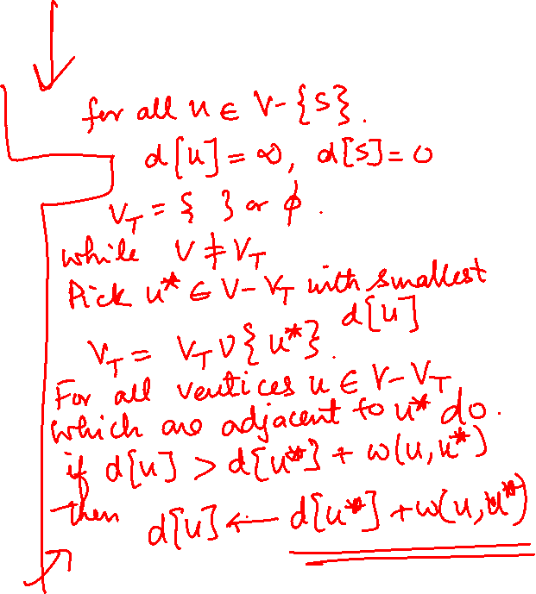
Graph Theory and its Applications Dijkstra’s Algorithm

Slide 14
Graph Theory and its Applications Dijkstra’s Algorithm- Time Efficiency
The time efficiency of Dijkstra’s algorithm depends on the data structures used for implementing the priority queue and for representing an input graph itself.
O(|V|²) for graphs represented by weight matrix and array implementation of priority queue
O(|E|log|V|) for graphs represented by adj. lists and min-heap implementation of priority queue

Slide 15
Graph Theory and its Applications Notes on Dijkstra’s Algorithm
Correctness can be proven by induction on the number of vertices.
Doesn’t work for graphs with negative weights (whereas Floyd’s algorithm does, as long as there is no negative cycle).
Applicable to both undirected and directed graphs
Don’t mix up Dijkstra’s algorithm with Prim’s algorithm!

Slide 16

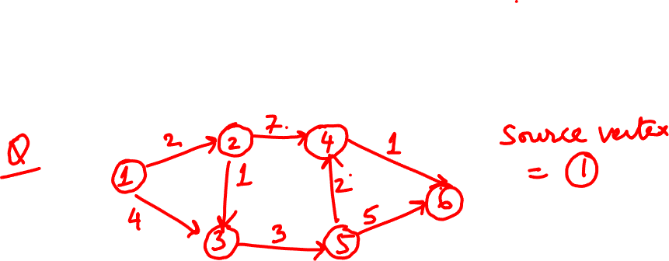
Design and Analysis of Algorithms Practice Questions

Slide 17
Graph Theory and its Applications Shortest Path Problem
The diagram below shows roads connecting nearby localities to university. The values on each arcs represent the distance in kilometers along each road. A student of the university lives in locality ‘A’. Use Dijkstra’s algorithm to find the minimum distance for student’s journey to university represented as ‘P’.
B
7 D
8
F
8
13
5
9
6
5
P
A
11
6
C
6
E
7
G

Slide 18
Graph Theory and its Applications Shortest Path Problem
Three boys walk to school J from their homes at A, B, and C. The graph shows the network of roads near their homes and school. The numbers on each arc represent the distance in meters along each road. Use Dijkstra’s algorithm to find which boy lives nearest to the school.
A
190
E
90
H
90
150
100
300
110
250
250
B
J
D
G
120
110
280
130
C
240
F 80
I

Slide 19
Graph Theory and its Applications Shortest Path Problem
The following network shows in time(mins) train journey between seven stations.
Given that there is no time delay in passing through a station find the
shortest time to travel from A to G.
Find the shortest time to travel from A to G if in reality, each time the train passes through a station, excluding A and G an extra 10 minutes is added to the journey time.
B
65
F
35
50
25
30
20
35
30
A
E
D 40
G
35
75
60
C

Slide 20
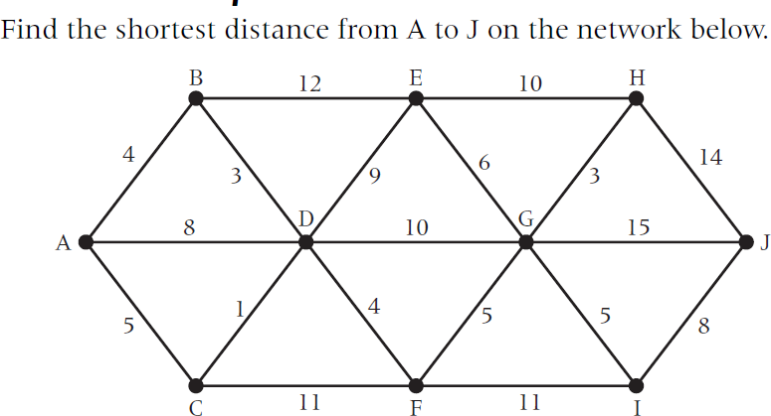
Graph Theory and its Applications Shortest Path Problem

Slide 21
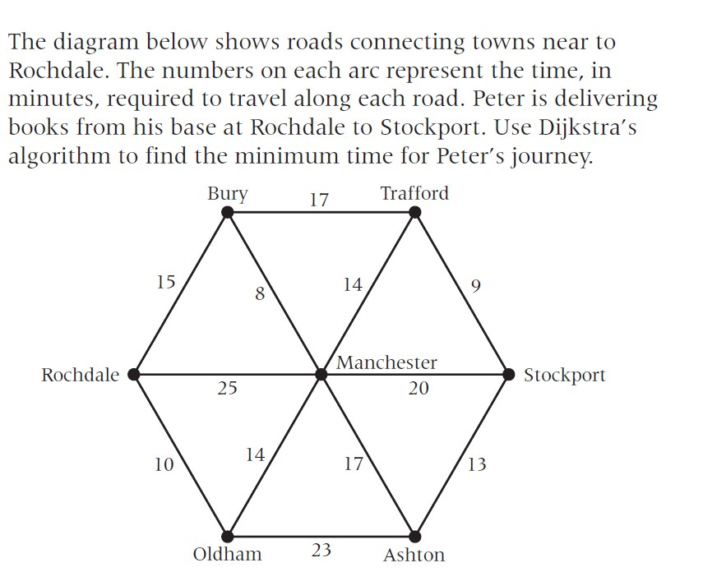
Graph Theory and its Applications Shortest Path Problem

Slide 22
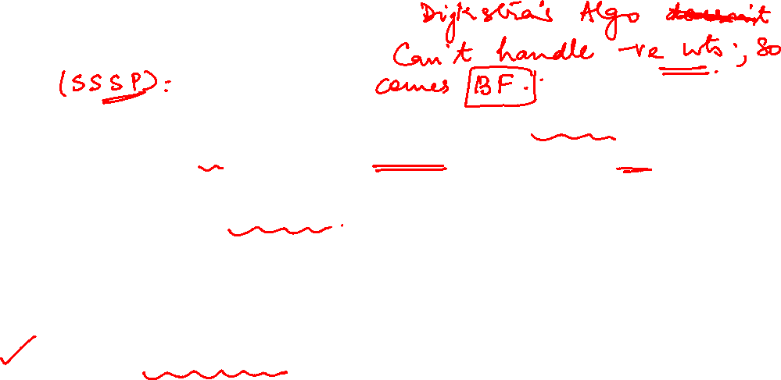
Graph Theory and its Applications
Bellman Ford Algorithm
The Bellman-Ford algorithm is an extension of Dijkstra’s algorithm which calculates the shortest distance from the source point to all of the vertices. While Dijkstra’s algorithm just works for edges with positive distances, the Bellman-Ford algorithm works for negative distances as well.
Applications:
The Bellman-Ford algorithm has several real-world use cases, including:
Finding negative weight cycles.
Calculating the smallest possible heat gain/loss in a chemical reaction.
Finding the most efficient way to convert currencies.

Slide 23
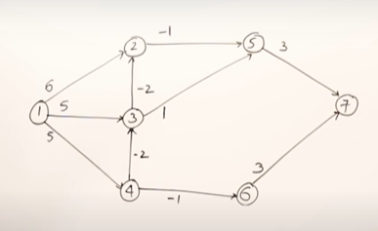
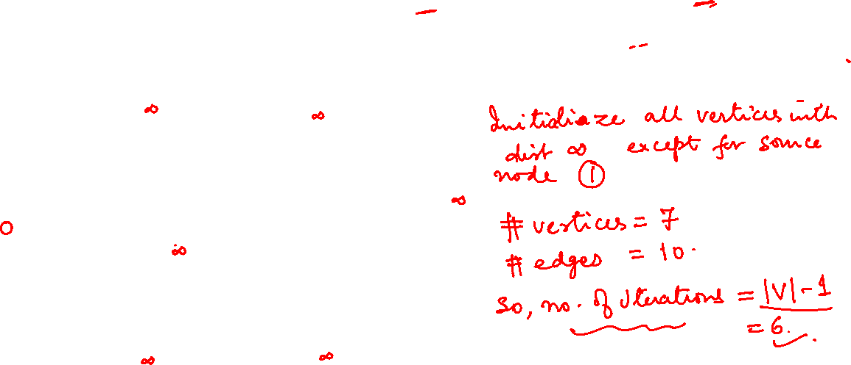
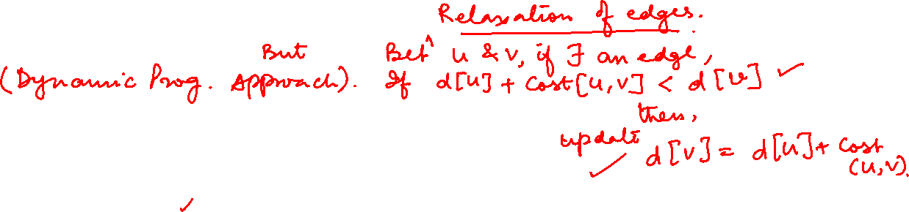
Graph Theory and its Applications
Bellman Ford Algorithm
Find the shortest distance from 1 using Bellman Ford Algorithm

Slide 24
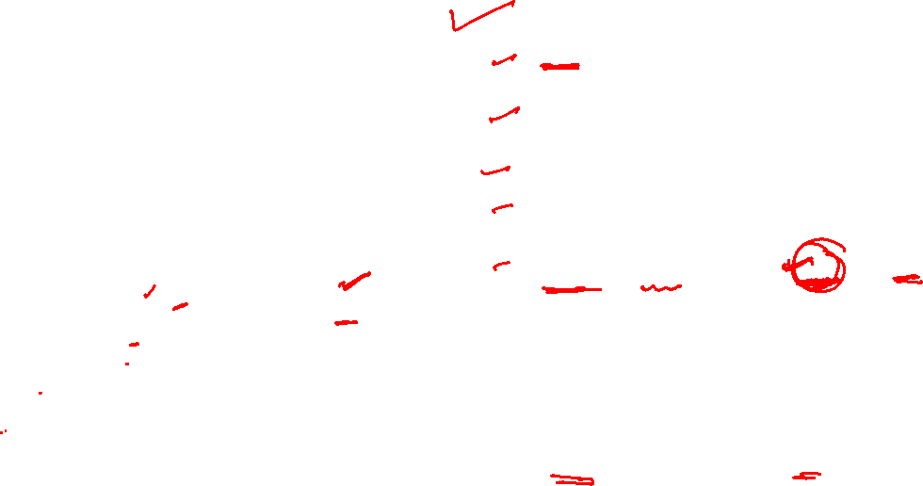
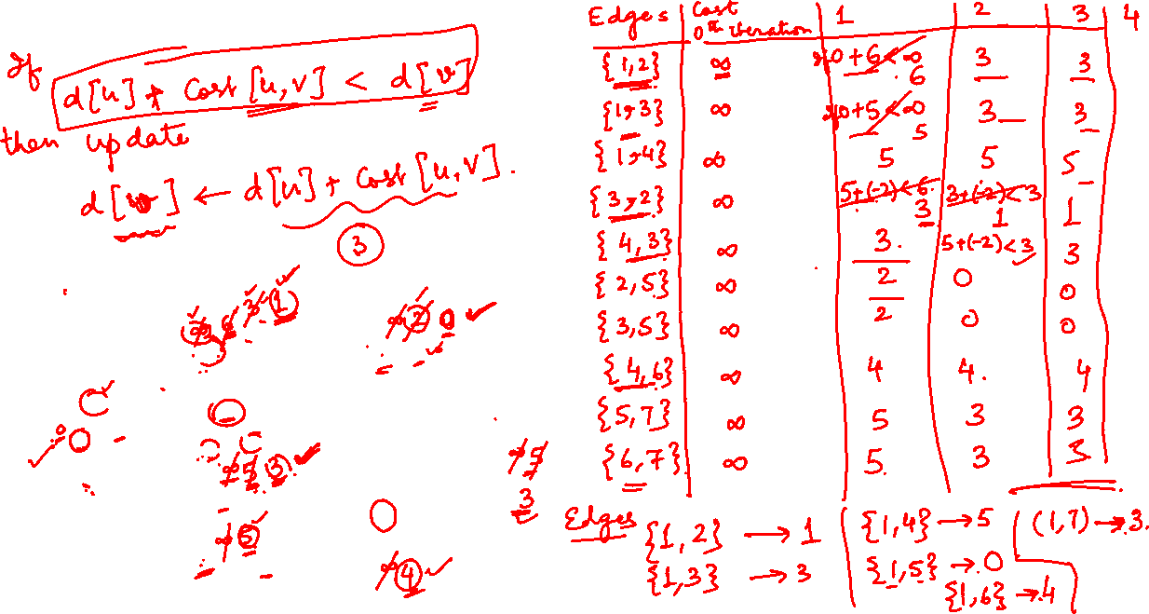

Slide 25
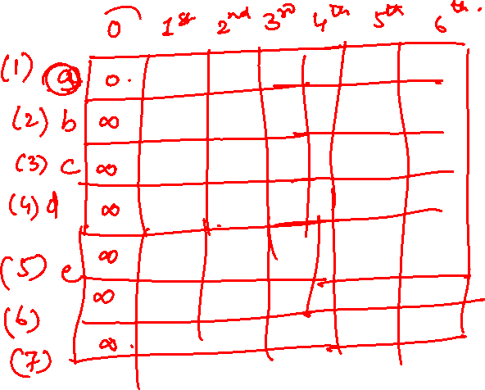

Slide 26
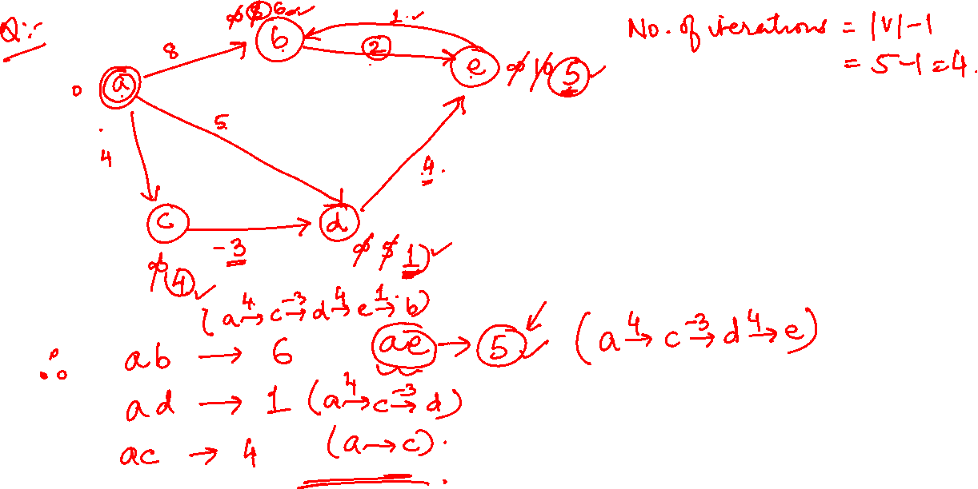

Slide 27
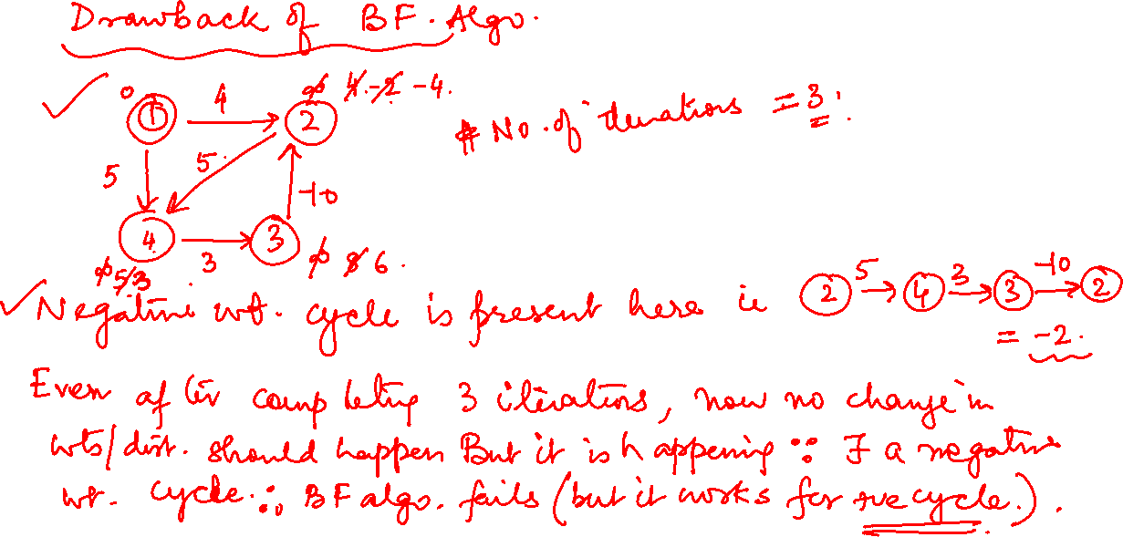

Slide 28

Graph Theory and its Applications
Bellman Ford Algorithm
1. List down all the edges of the graph. This can be done easily if the graph is
represented by an adjacency list.
Calculate the number of iterations with “V – 1”. The number of iterations will be equal to the number of vertices because the shortest distance to an edge can be adjusted |V-1| times at maximum.
Start with an arbitrary vertex and assign it the minimum distance of zero. All other nodes should be assigned infinity since we are exaggerating the actual distances.
In each iteration, update the distance for each edge if the new distance is smaller than the one assigned before. The distance to each node will be the cumulative distance from the starting node to this particular node.
We need to consider all the iterations to make sure that all possible paths are considered. If we do this, we will end up with the shortest distance.

Slide 29
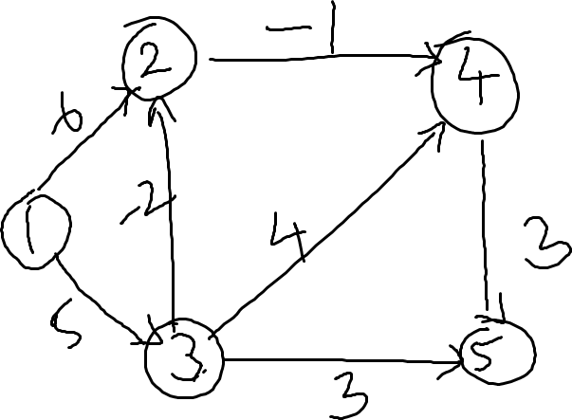
Graph Theory and its Applications Shortest Path Problem
Find the shortest distance from 1 using Bellman Ford Algorithm

Slide 30
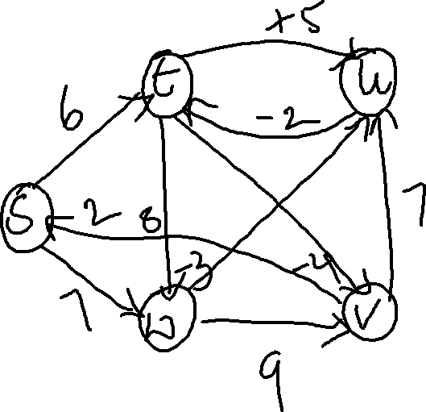
Graph Theory and its Applications Shortest Path Problem
Find the shortest distance from S using Bellman Ford Algorithm

Slide 31
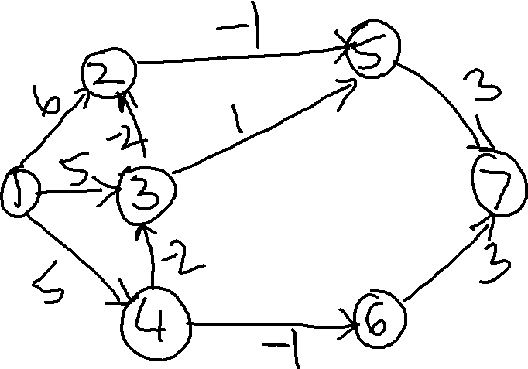
Graph Theory and its Applications Shortest Path Problem
Find the shortest distance from 1 using Bellman Ford Algorithm

Slide 32
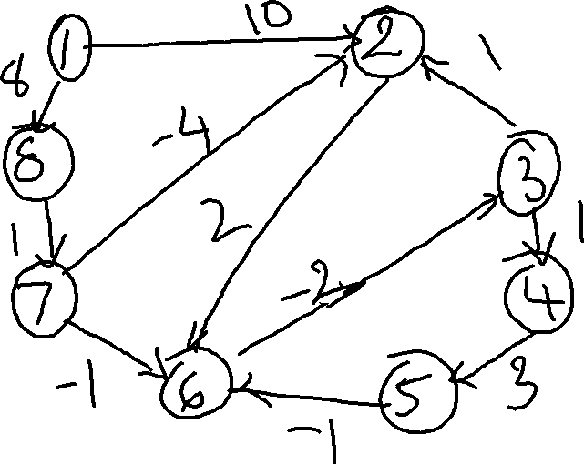
Graph Theory and its Applications Shortest Path Problem
Find the shortest distance from 1 using Bellman Ford Algorithm

Slide 33
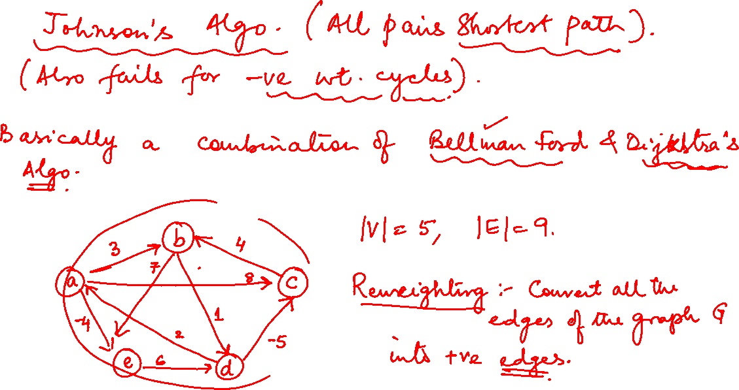

Slide 34
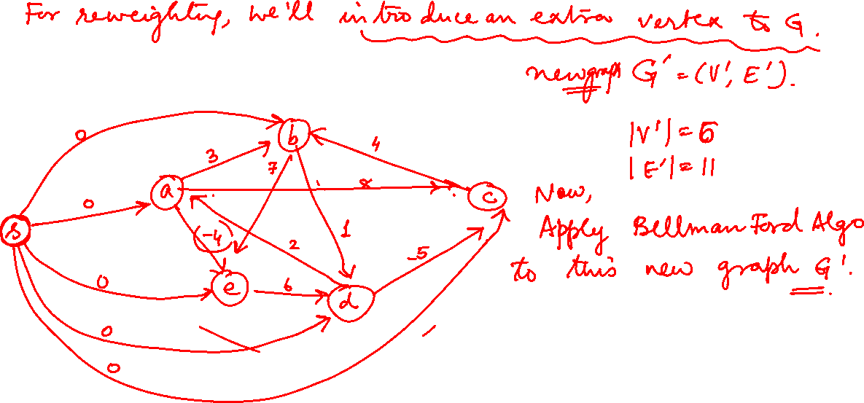


Slide 35
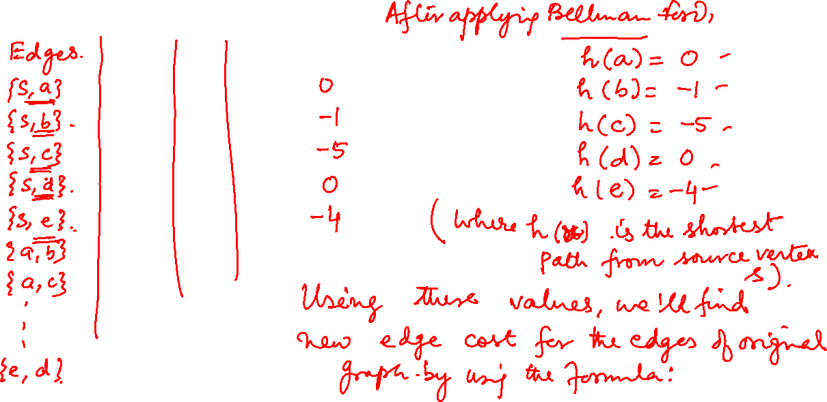


Slide 36
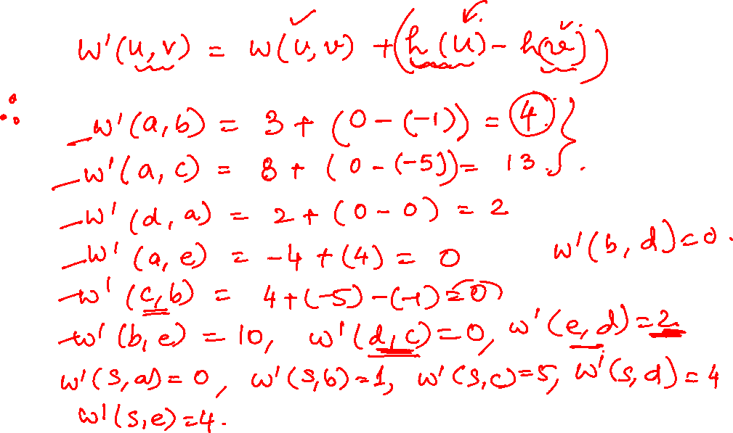

Slide 37
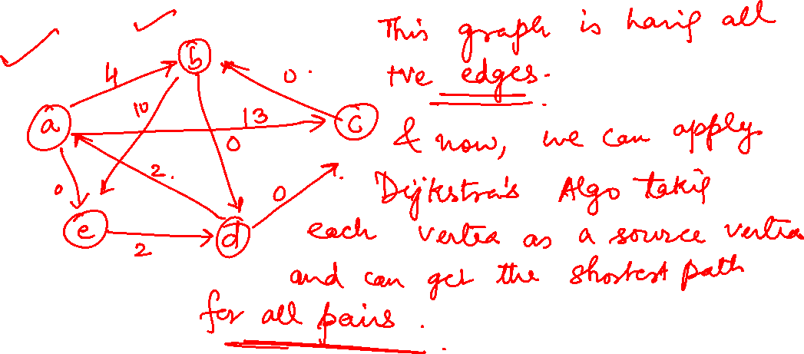

Slide 38
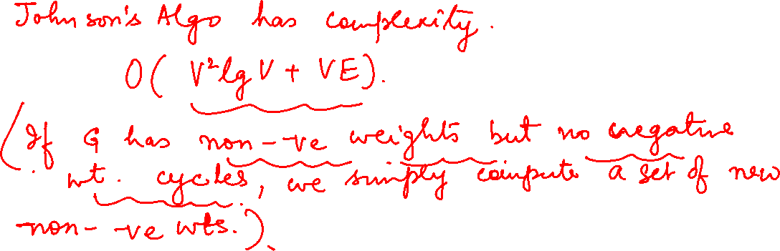

Slide 39
Graph Theory and its Applications
ALL PAIRS SHORTEST PATHS
Consider the problem of finding shortest paths between all pairs of vertices in a graph. This problem might arise in making a table of distances between all pairs of cities for a road atlas.
we are given a weighted, directed graph G=(V,E) with a weight function w: W -> R that maps edges to real-valued weights.
We wish to find, for every pair of vertices u, v belongs to V , a shortest (least- weight) path from u to , where the weight of a path is the sum of the weights of its constituent edges. We typically want the output in tabular form: the entry in u’s row and ’s column should be the weight of a shortest path from u to .

Slide 40
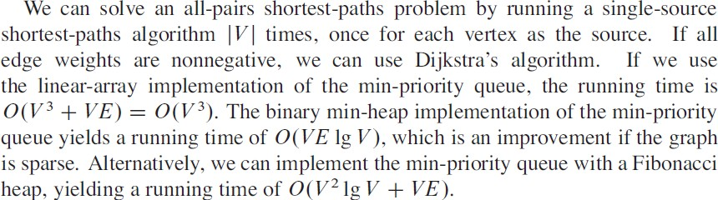
Graph Theory and its Applications ALL PAIRS SHORTEST PATHS

Slide 41
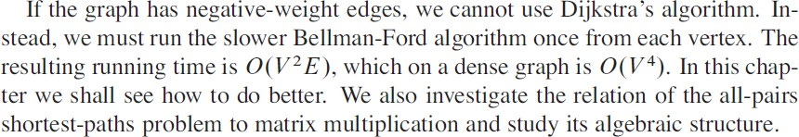
Graph Theory and its Applications ALL PAIRS SHORTEST PATHS

Slide 42
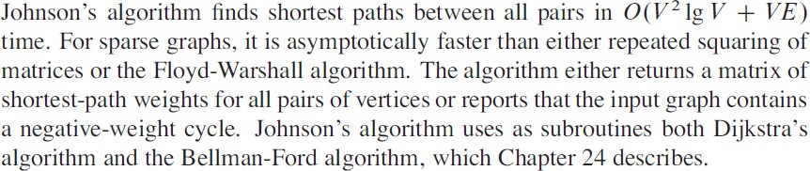
Graph Theory and its Applications Johnson’s Algorithm for Sparse Graphs
Johnsons Algorithm for Sparse Graphs

Slide 43

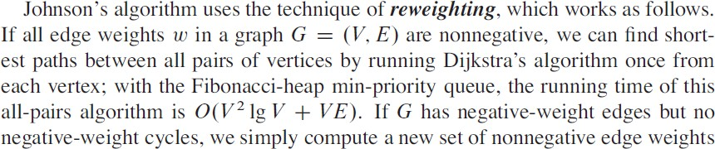
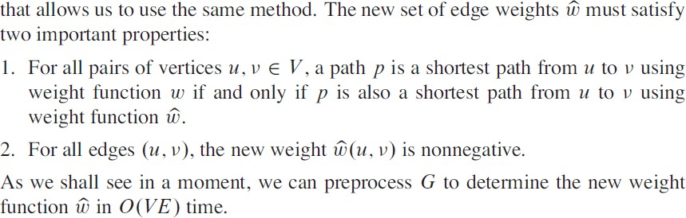
Graph Theory and its Applications ALL PAIRS SHORTEST PATHS

Slide 44
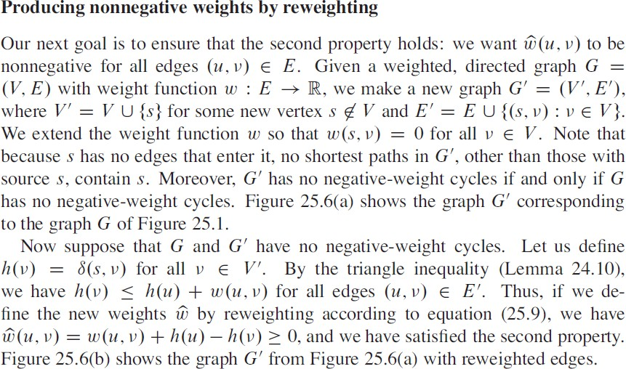
Graph Theory and its Applications ALL PAIRS SHORTEST PATHS

Slide 45
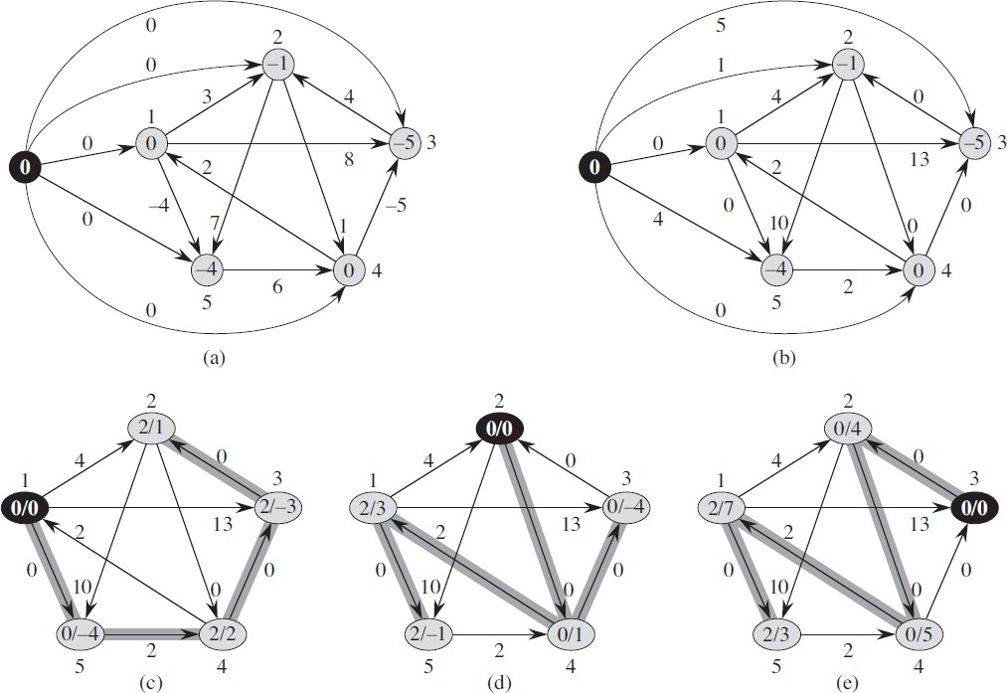

Graph Theory and its Applications ALL PAIRS SHORTEST PATHS

Slide 46
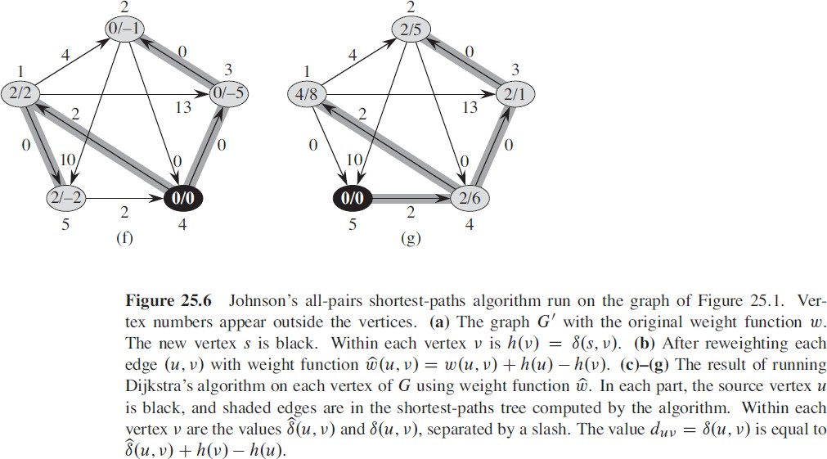
Graph Theory and its Applications ALL PAIRS SHORTEST PATHS

Slide 47
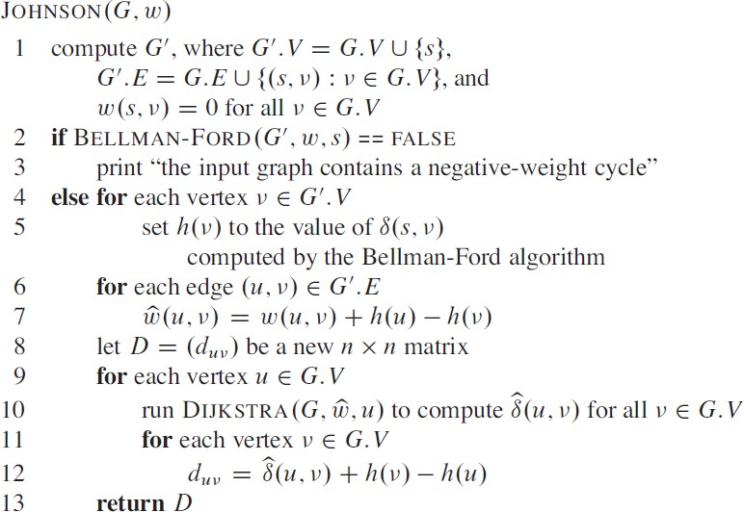
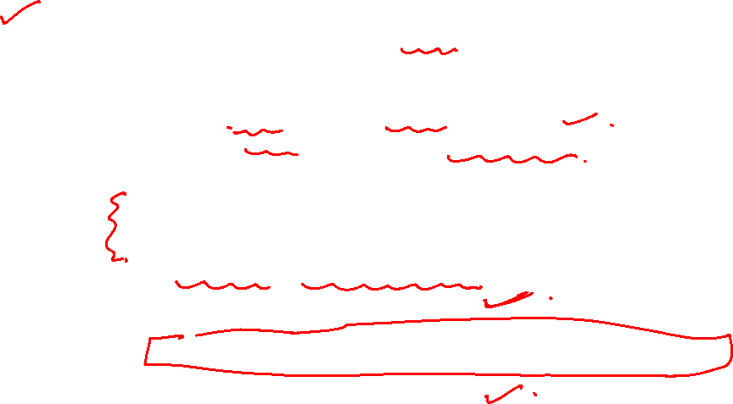
Graph Theory and its Applications ALL PAIRS SHORTEST PATHS

Slide 48
THANK YOU
Dr. Arti Arya
Department of Computer Science &Engineering
artiarya@pes.edu

